Slide 1

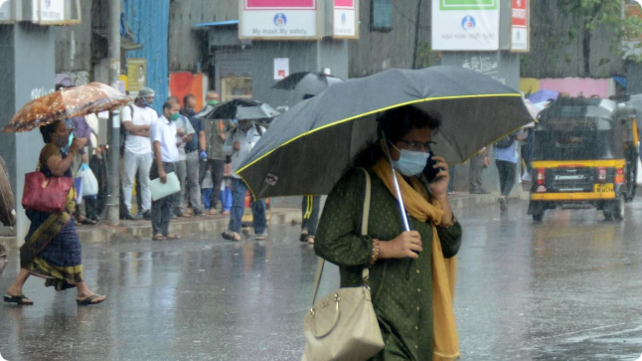
Challenges & Remedies of Floods in Maharashtra
Flooding is a recurring issue in Maharashtra, impacting lives and livelihoods. This presentation explores the challenges and remedies associated with flood management in the state.
SS
by Sachin Shinde

Slide 2

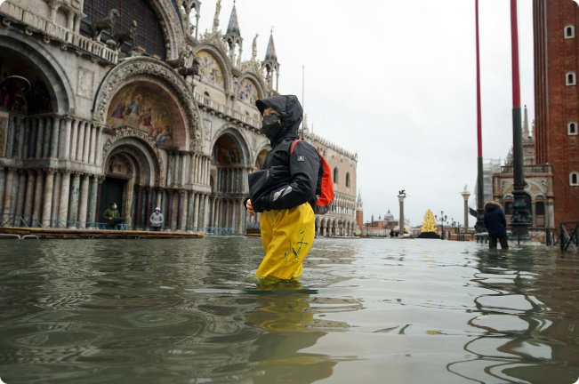
Challenges in Flood Management
1
Urbanization
2
Climate Change
Rapid urbanization in Maharashtra has led to increased impervious surfaces, reducing water absorption and exacerbating flood risks.
Climate change has altered rainfall patterns, leading to more intense and frequent monsoon events, increasing the likelihood of flooding.
3
Poor Infrastructure
4
Population Density
Inadequate drainage systems and outdated infrastructure contribute to waterlogging and flooding, especially in urban areas.
Densely populated areas are more vulnerable to flooding due to limited evacuation options and potential for overcrowding.

Slide 3
Impact of Floods
Human Impact
Economic Impact
Environmental Impact
Loss of life and displacement of communities. Damage to homes and infrastructure. Health risks due to contaminated water and disease outbreaks.
Damage to crops and agricultural land. Disruption of supply chains and business operations. Loss of income and livelihood opportunities.
Erosion of soil and degradation of ecosystems. Pollution of water bodies and contamination of groundwater sources.

Slide 4


Flood Economy and Responses
1
Emergency Response
Immediate actions to rescue and evacuate people, provide food, water, and shelter, and address immediate needs.
2
Reconstruction and Rehabilitation
Restoring damaged infrastructure, rebuilding homes and businesses, providing financial assistance, and supporting economic recovery.
3
Long-Term Adaptation
Implementing measures to improve flood resilience, such as strengthening infrastructure, restoring ecosystems, and promoting sustainable development.

Slide 5

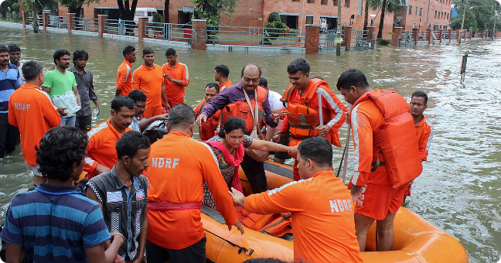
Flood Response Forces
Agency
Role
National Disaster Response Force (NDRF)
Search and rescue operations, medical assistance, and disaster relief.
State Disaster Response Force (SDRF)
Supports NDRF in disaster response and provides localized assistance.
Indian Army and Navy
Provide assistance in large-scale disaster relief, including evacuation and transportation.
Local Government and Police
Coordinate rescue efforts, manage shelters, and provide basic necessities.

Slide 6

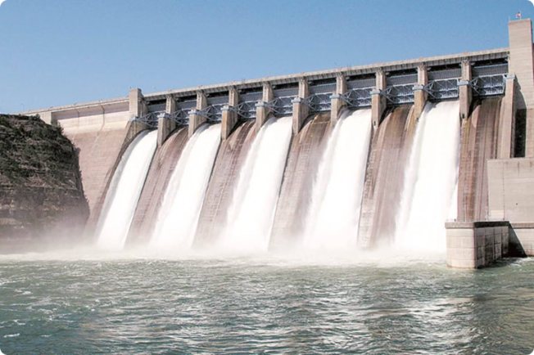
Flood Mitigation Strategies
Infrastructure Development
Land Use Planning
Restricting development in flood-prone areas, promoting green spaces and permeable surfaces, and implementing zoning regulations.
Strengthening existing drainage systems, constructing floodwalls, and implementing early warning systems.
Community Awareness
Ecosystem Restoration
Educating communities about flood risks, promoting preparedness measures, and encouraging participation in disaster management programs.
Rehabilitating wetlands and forests, promoting afforestation, and preserving natural floodplains to enhance water retention.

Slide 7


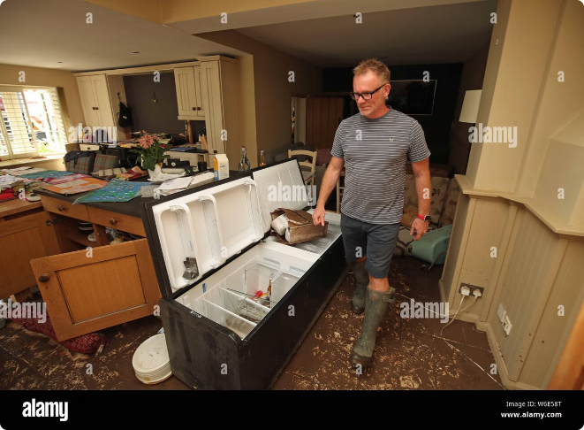



Role of Government and Authorities
Policy Formulation
Developing comprehensive flood management policies, allocating resources, and ensuring effective implementation.
Infrastructure Investment
Investing in flood control infrastructure, upgrading drainage systems, and building resilience into urban planning.
Community Engagement
Engaging with communities in flood preparedness planning, promoting awareness, and fostering collaboration.
Disaster Response Coordination
Establishing efficient disaster response mechanisms, coordinating with various agencies, and ensuring timely and effective relief.

Slide 8



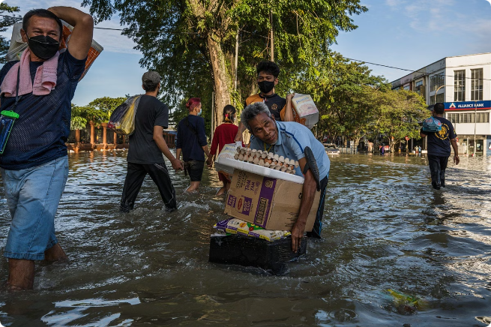


Community Participation in Flood Management
Awareness Campaigns
Volunteerism
Organizing awareness programs to educate communities about flood risks, preparedness measures, and safety protocols.
Encouraging community participation in disaster preparedness, response, and recovery efforts.
Knowledge Sharing
Collaboration
Facilitating the exchange of local knowledge and experiences to improve flood management practices.
Building partnerships between communities, government agencies, and NGOs to strengthen flood resilience.

Slide 9

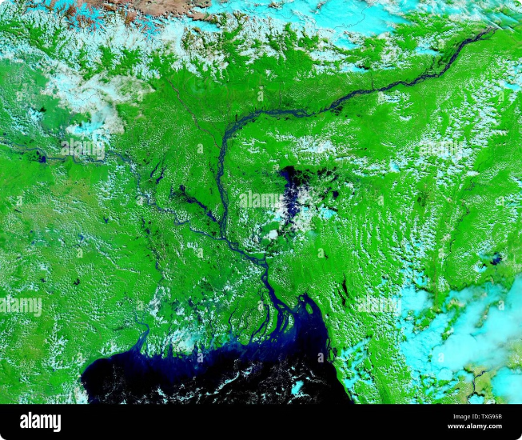
Lessons Learned from Past Flood Events
1
Early Warning Systems
2
Infrastructure Deficiencies
Importance of accurate and timely warnings to enable proactive response and minimize damage.
Need for investment in robust infrastructure to withstand extreme weather events and reduce flooding risks.
3
Community Resilience
4
Sustainable Development
Critical role of community preparedness, training, and participation in disaster response.
Importance of promoting environmentally sound practices and integrated flood management strategies for long-term resilience.

Slide 10


Towards a Resilient Maharashtra
Through effective flood management strategies, collaborative efforts, and a focus on sustainable development, Maharashtra can build resilience against the impacts of flooding and ensure a safer and more prosperous future for its people.

